Slide 1
CAM5.5/CESM2
CLUBB and more

Slide 2
Outline
CMIP6 development process
CLUBB
Orographic precip bias

Slide 3
What’s happening for CMIP6
CMIP6 model will be 1ºx1º w/ FV dycore
Atmospheric physics changes
CLUBB (replaces PBL, Shallow conv., cloud macro.)
MG2 microphysics
Turbulent mountain stress➔Beljaars+Anisotropic OGW?
Re-tuning of ZM deep scheme
Many changes to other components

Slide 4
Why decisions were made
Spectral element dycore led to cooling in coupled simulations and somewhat slower
New schemes (e.g. CLUBB) chosen primarily because they advance physical representation
Universal, simple climate model metrics don’t exist
Some “show stoppers” do
Code quality/Collaboration

Slide 5
CESM Requirements
Well balanced coupled runs
Reasonable 20th century simulation
Reasonable ENSO
Stratospheric chemistry
Good timing of SH vortex breakdown
Fast enough for long Paleo runs

Slide 6
Initial Evaluation and tuning
“AMIP-type” runs: prescribed SSTs. Interactive land-surface. 10+ years
Basic climate
Pre-industrial control runs (coupled). 10 years
Balance
Iterated tweaks of tunable parameters
Alternative approaches (for climate): Data Assimilation, CAPT (T-AMIP) forecasts??
Isn’t yet part of the “culture”

Slide 7
Evaluation and tuning: metrics
Taylor diagrams
Top-of-atmosphere (TOA) radiation balance
…..
……???
No simple single-number metric exists

Slide 8
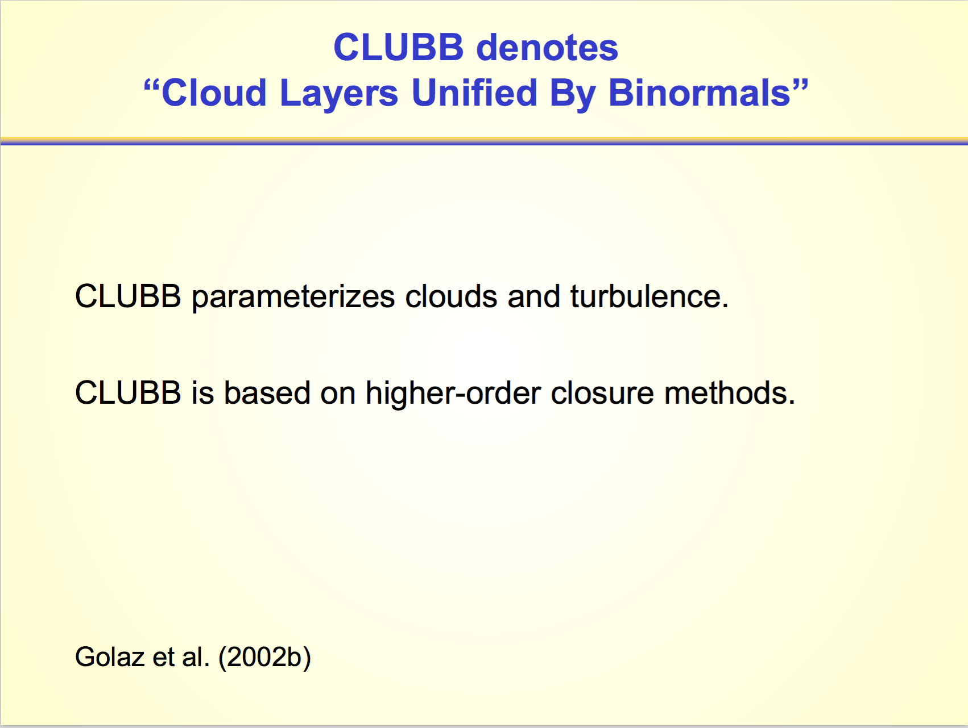

Slide 9
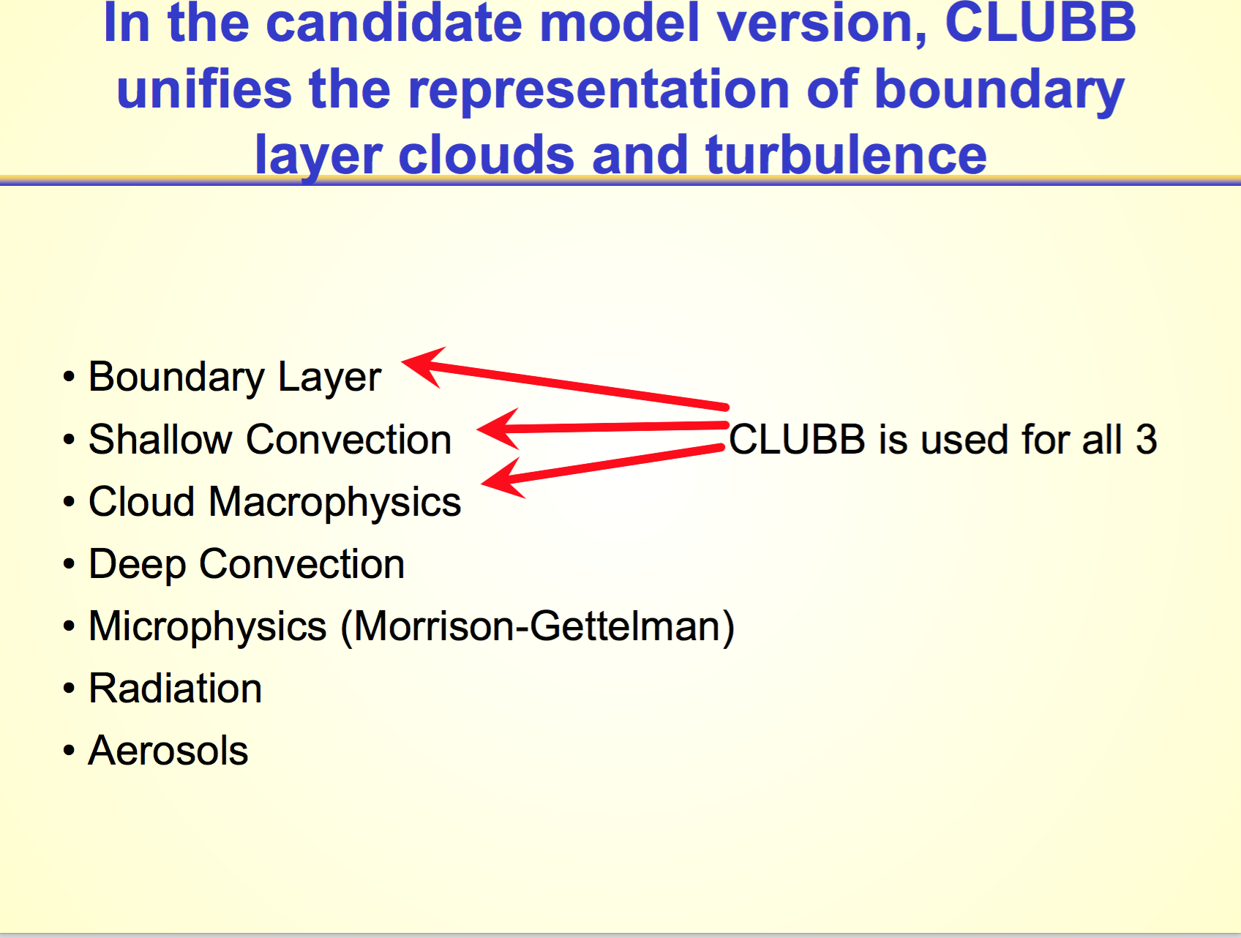

Slide 10
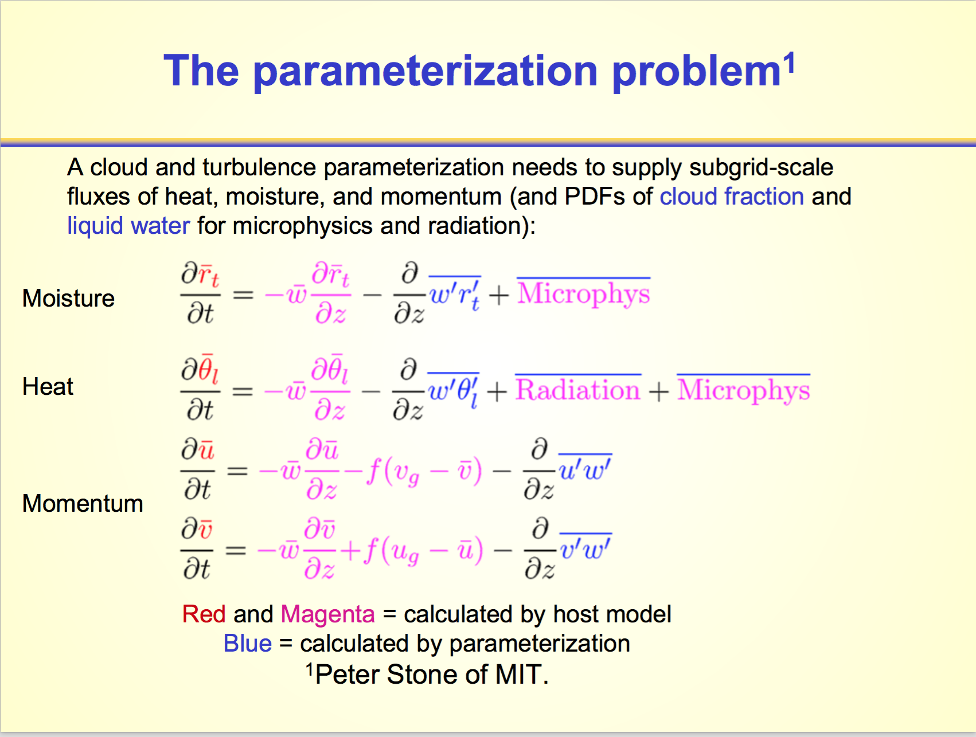

Slide 11
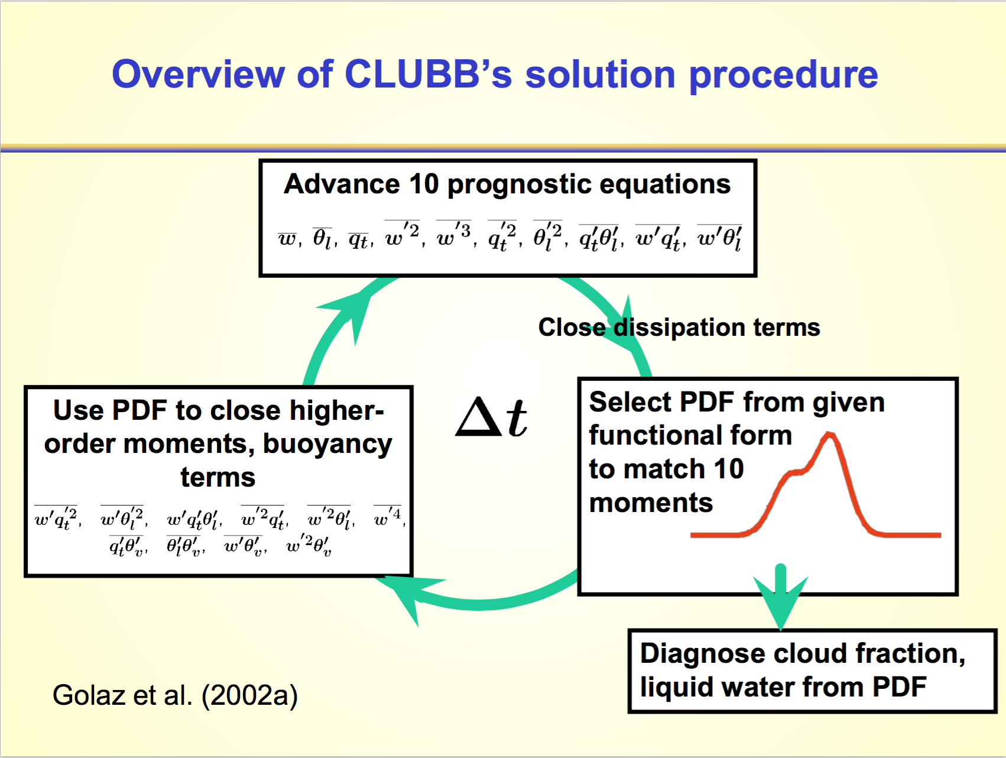

Slide 12
Note:
No equations for
Bi-normal PDFs

Slide 13
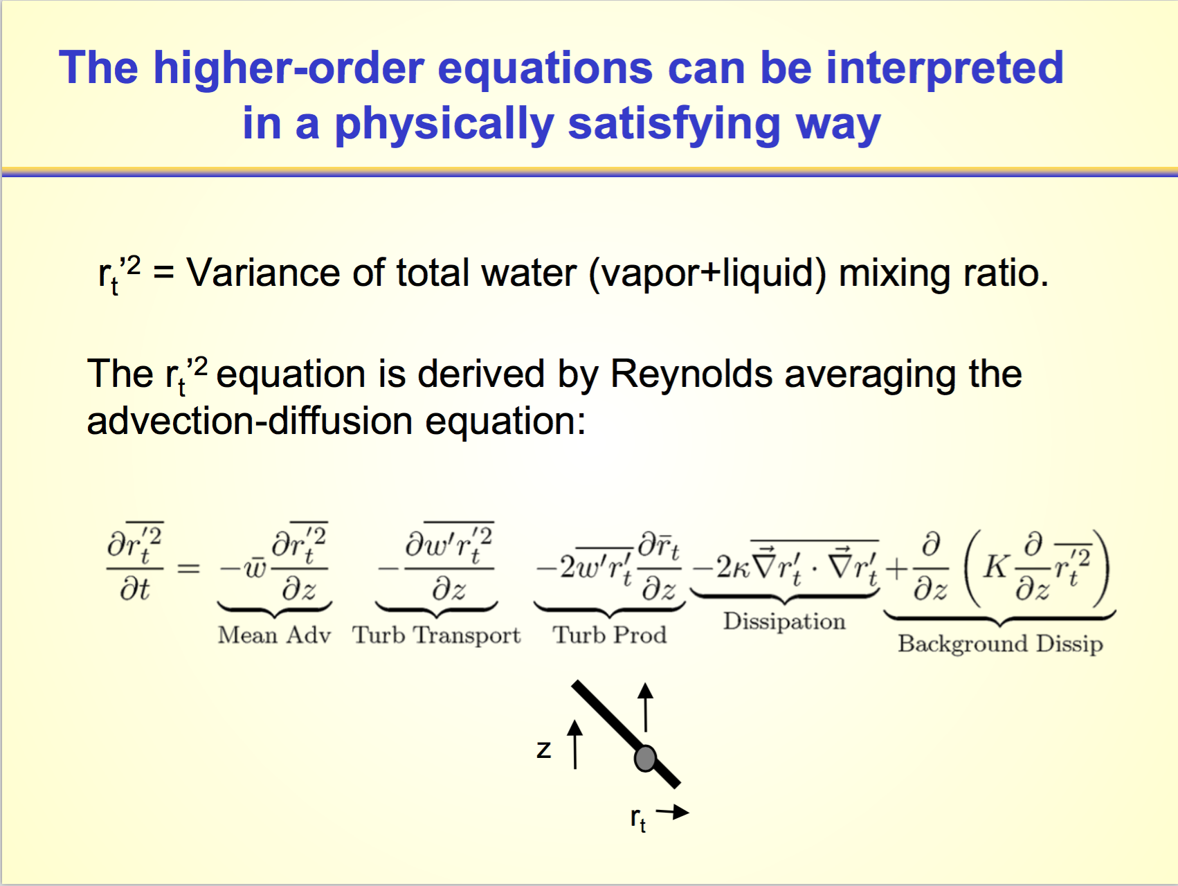

Slide 14
Head-to-head comparison of CAM with and without CLUBB in AMIP runs

Slide 15
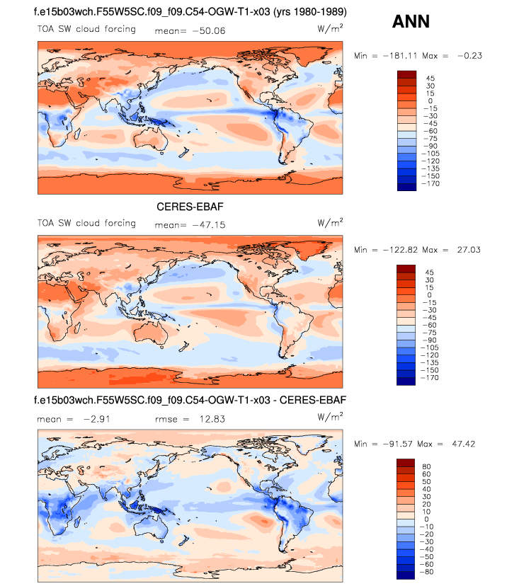
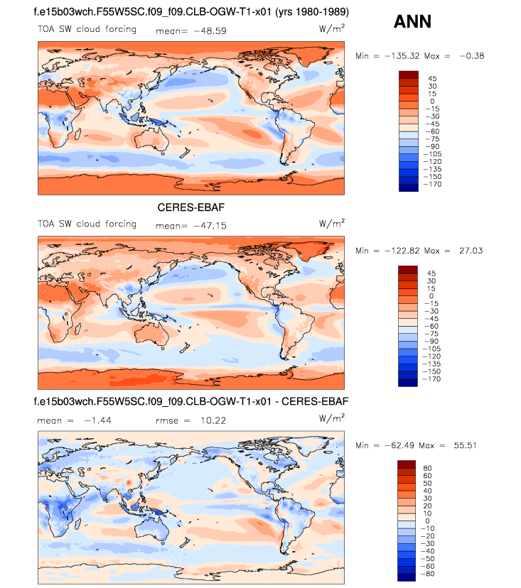
Annual mean shortwave cloud forcing
CAM5.4 (before CLUBB)
CAM5.5 (uses CLUBB)

Slide 16
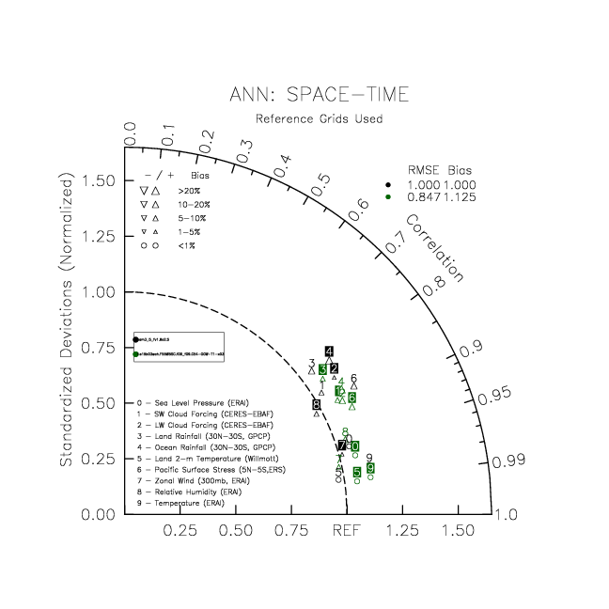
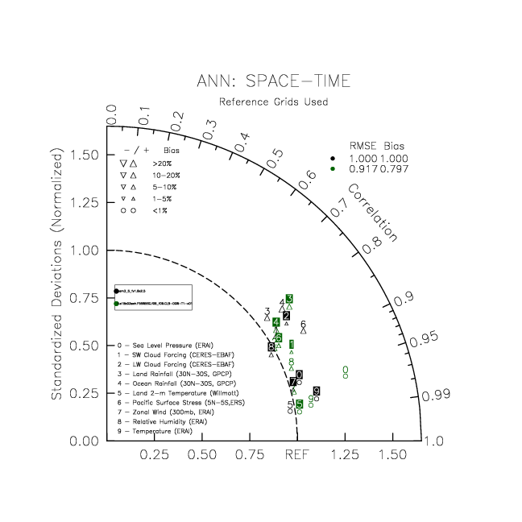
Taylor diagrams
CAM5.4 (before CLUBB)
CAM5.5 (uses CLUBB)

Slide 17
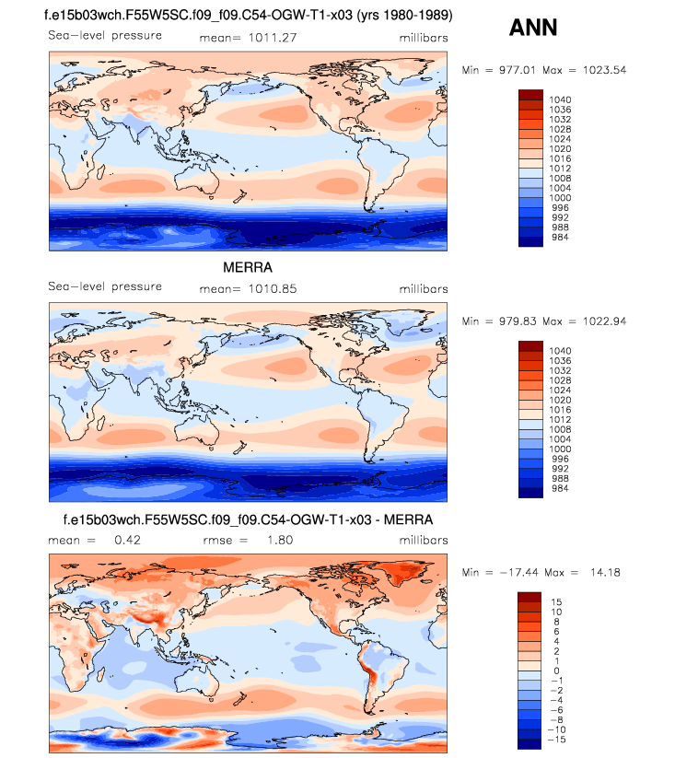
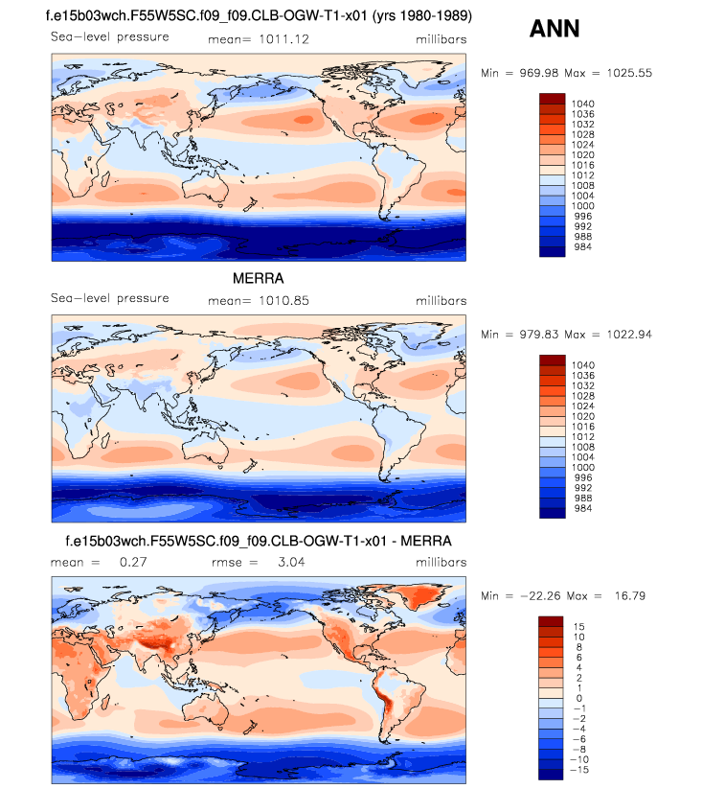
Annual mean sea-level pressure
CAM5.4 (before CLUBB)
CAM5.5 (uses CLUBB)

Slide 18
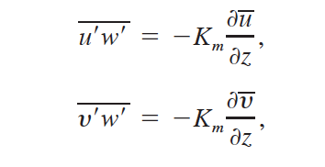
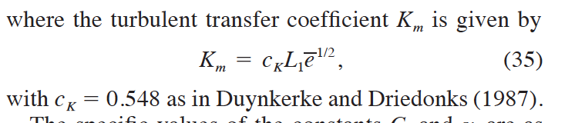
Momentum transport in CLUBB
“ck10” set to 0.3 in default configuration.

Slide 19
cK10 sensitivity in short coupled runs

Slide 20
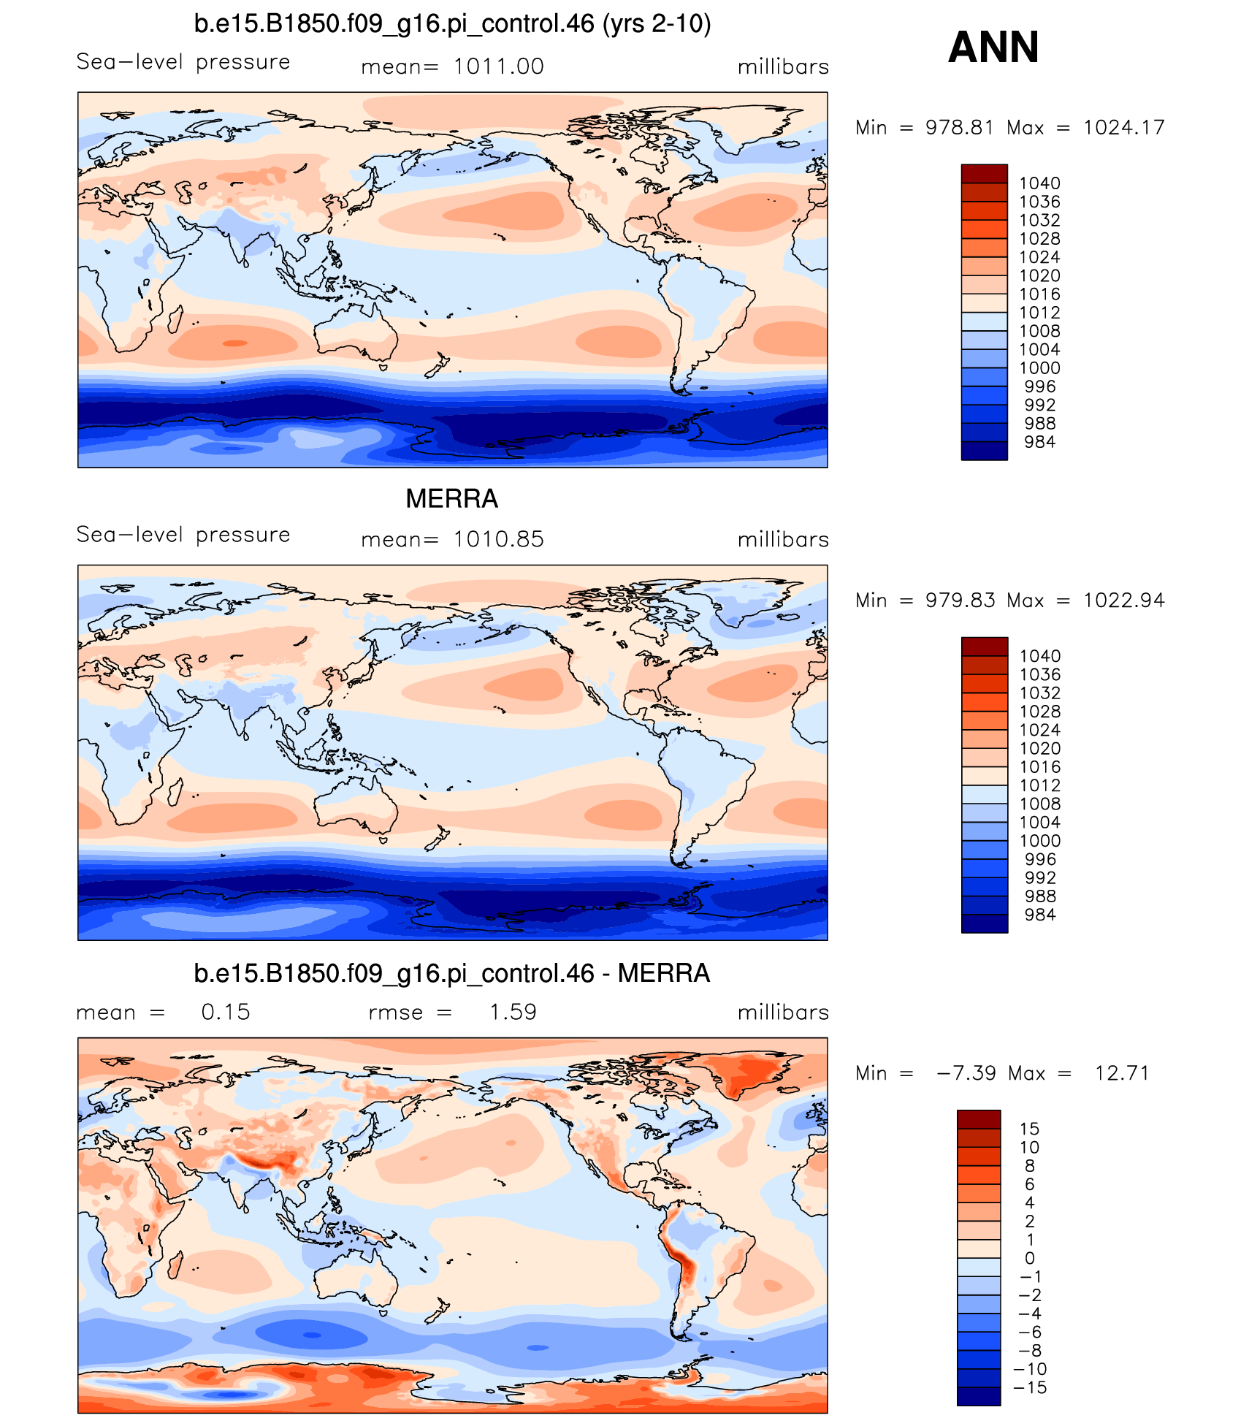
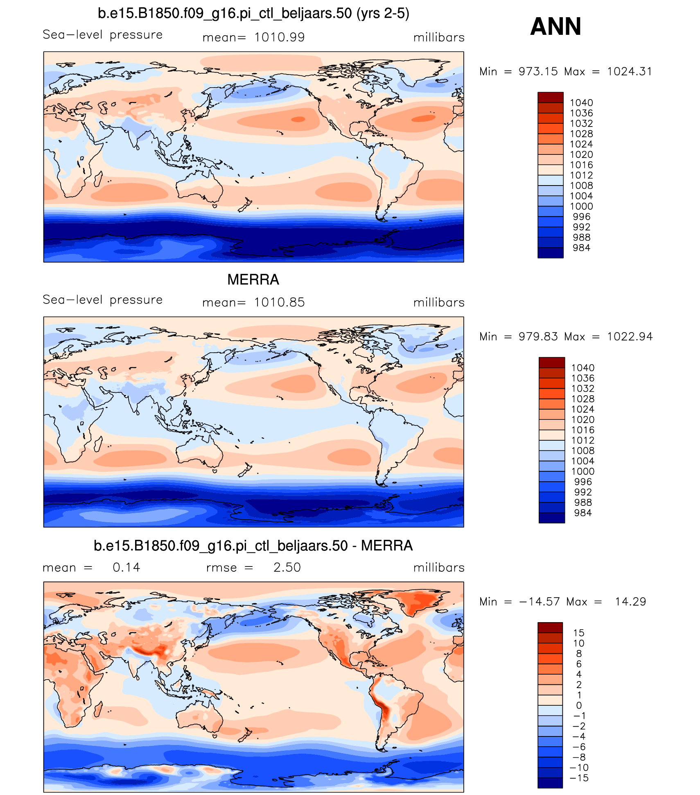
Annual mean sea-level pressure
cK10=0.6
cK10=0.3

Slide 21
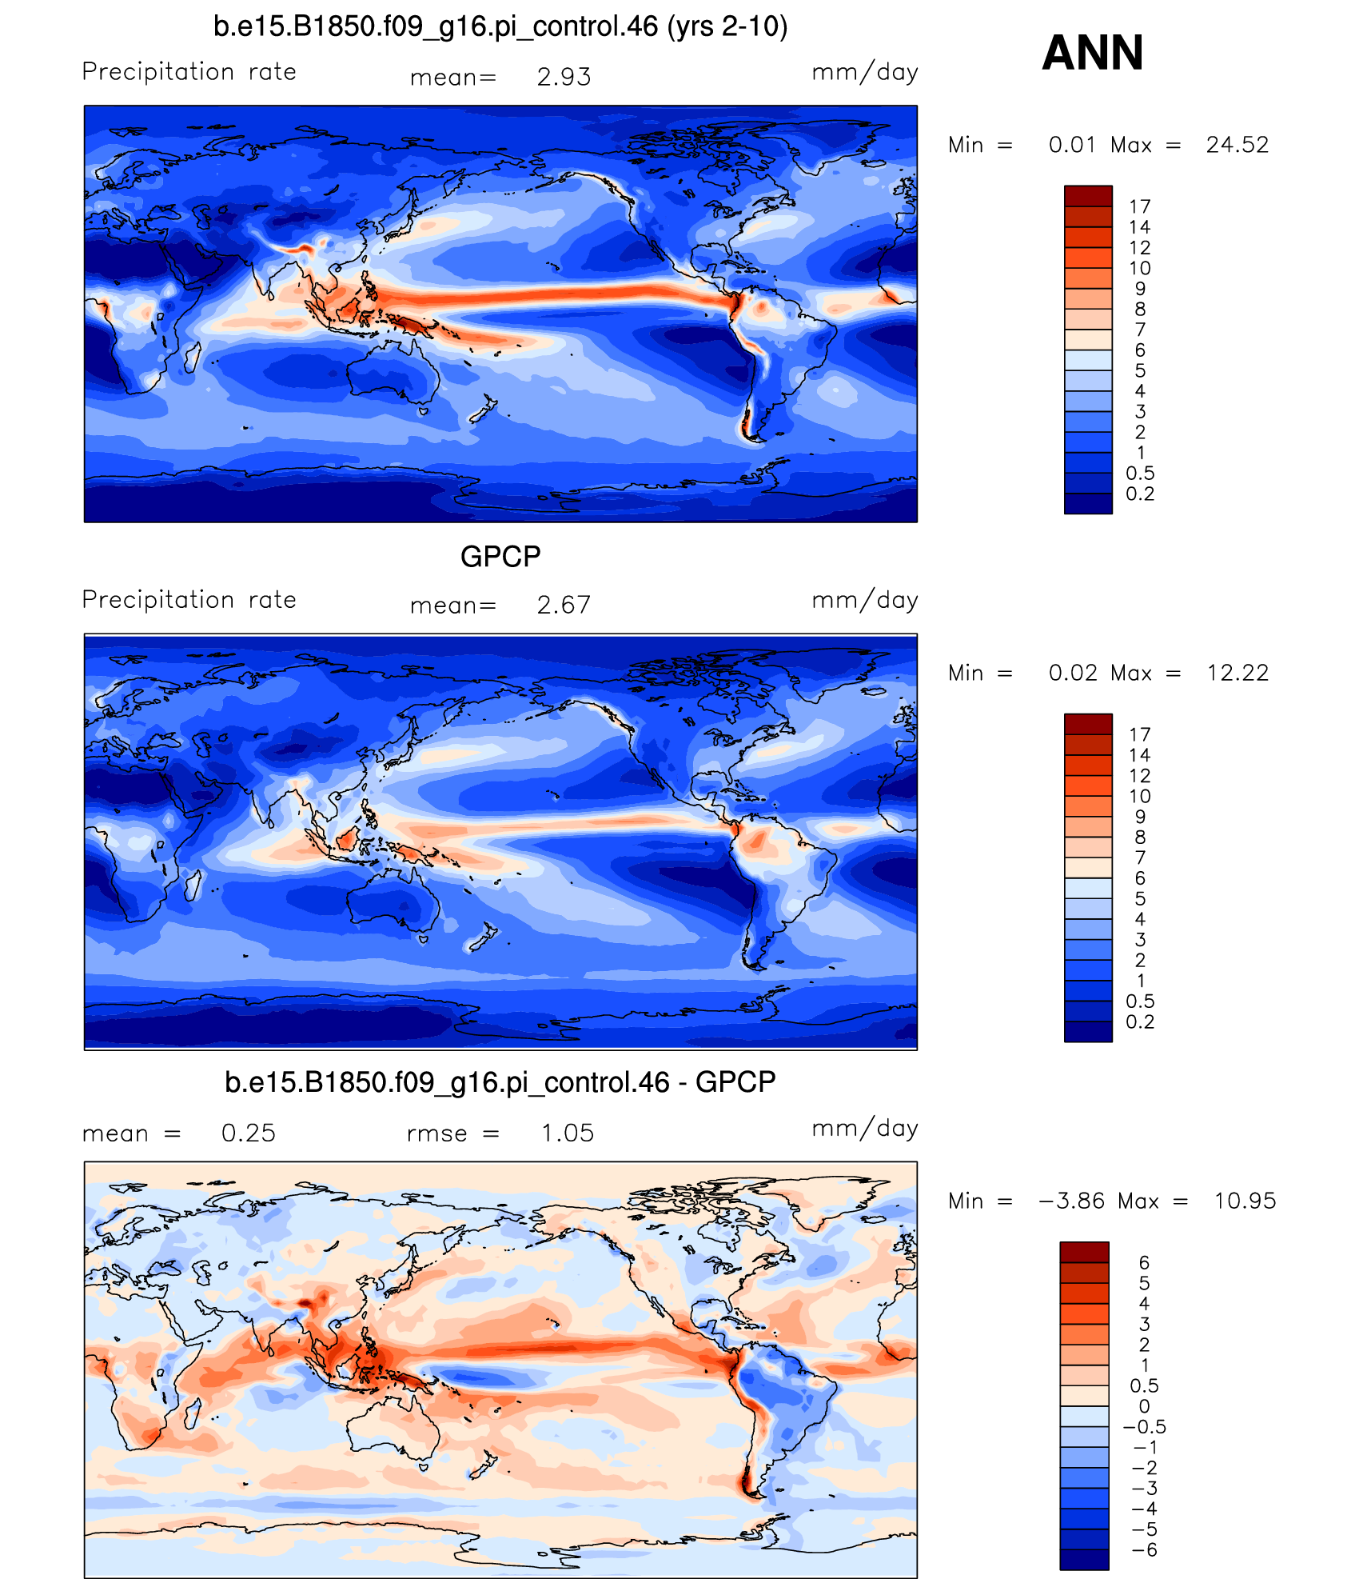
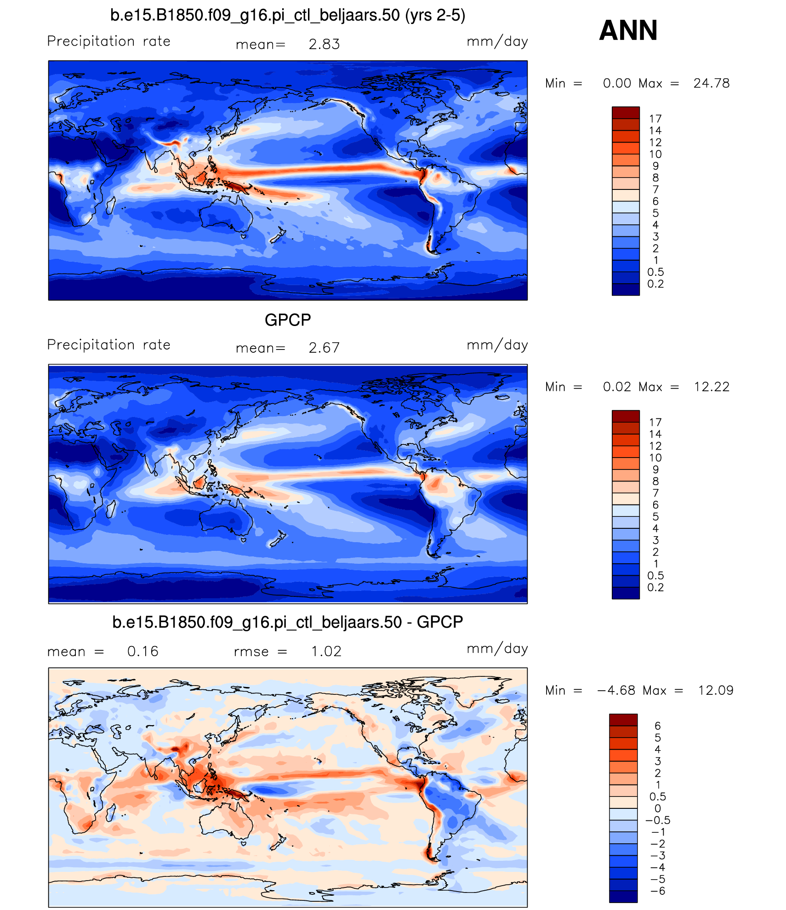
Annual mean sea-level precip
cK10=0.6
cK10=0.3
Too much rain/evap
Run is cooling !!

Slide 22
Data Assimilation tests
NCAR’s data assimilation research testbed (DART; Anderson et al . )
Ensemble Kalman filter
Radiosondes, cloud track winds, GPS
No radiance assimilation
Look at innovations to assess model performance

Slide 23
DAS innovations over 15 Jan-15 Feb
U(100m) (second level)

Slide 24
Precip bias over the Andes

Slide 25
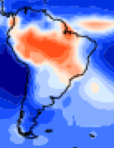
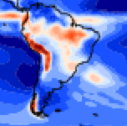
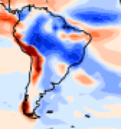
Obs
Ctl
Ctl-obs

Slide 26
Turn heating off where there is rough topography
Where subgrid std dev of topography exceeds 300m turn off CLUBB, convective, and microphysical heating
No moist heating

Slide 27
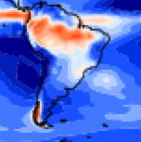
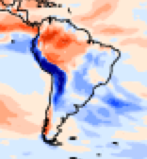
Obs
Ctl
noHt
Ctl-obs
noHt-Ctl

Slide 28
Summary
Initial tuning of CAM5.5 still underway
DAS tests seem meaningful. Unclear how to use results.
Orographic biases can have important non-local effects. No clear path to fixing these.

Slide 29
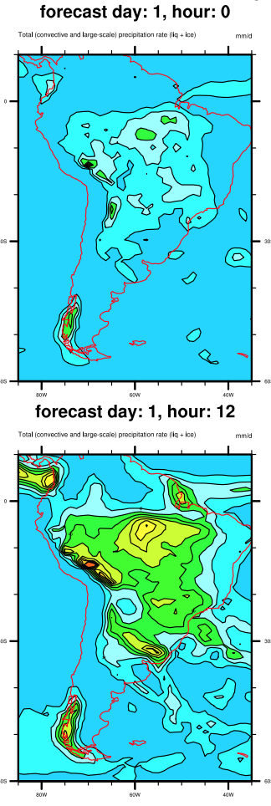
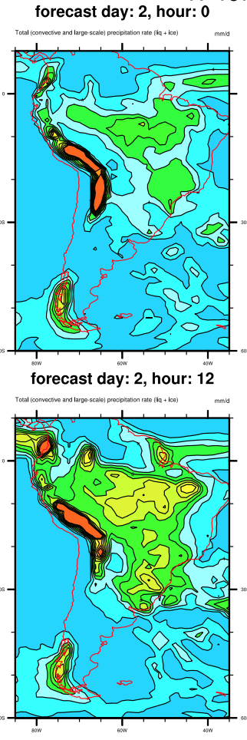
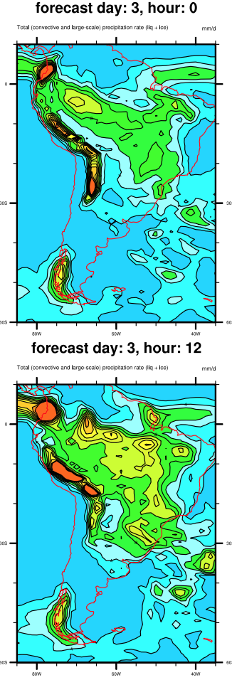
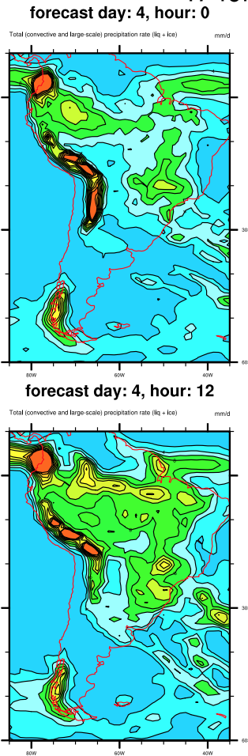
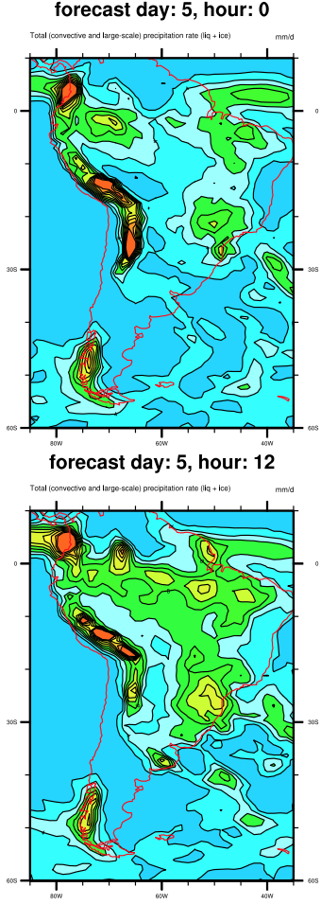

Slide 30
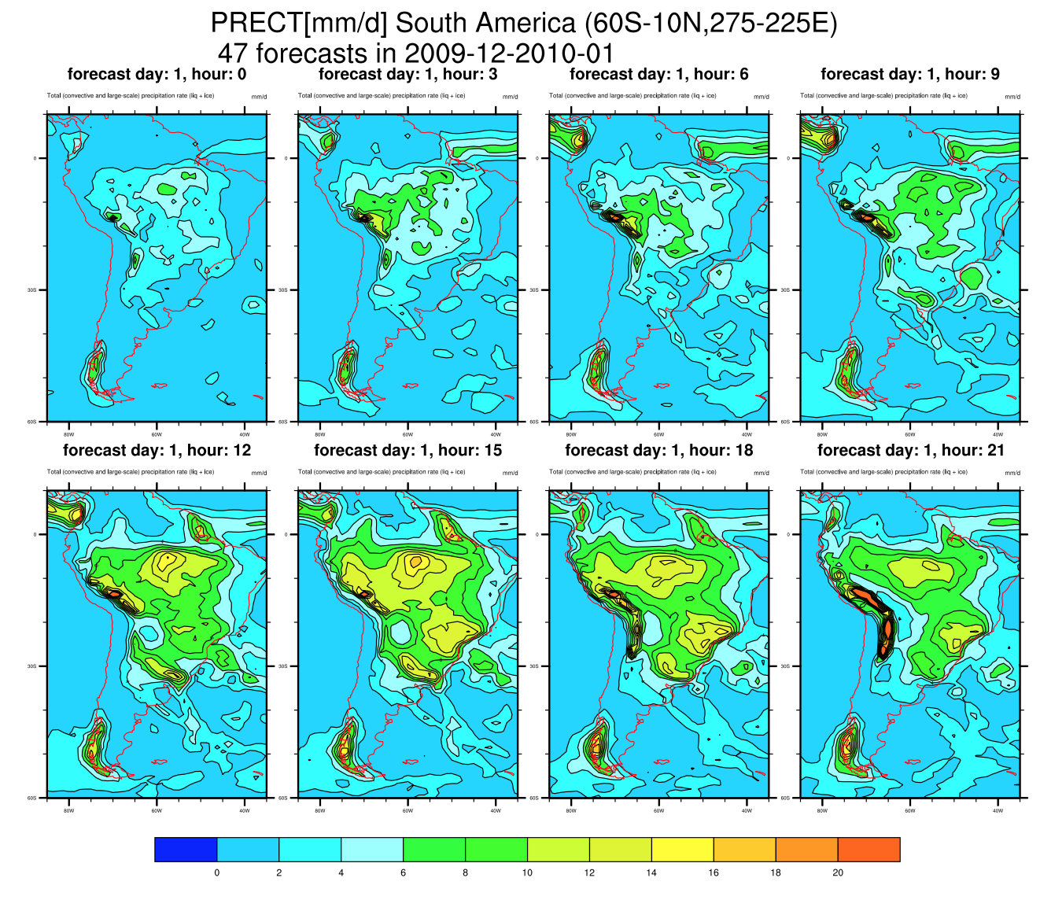

Slide 31
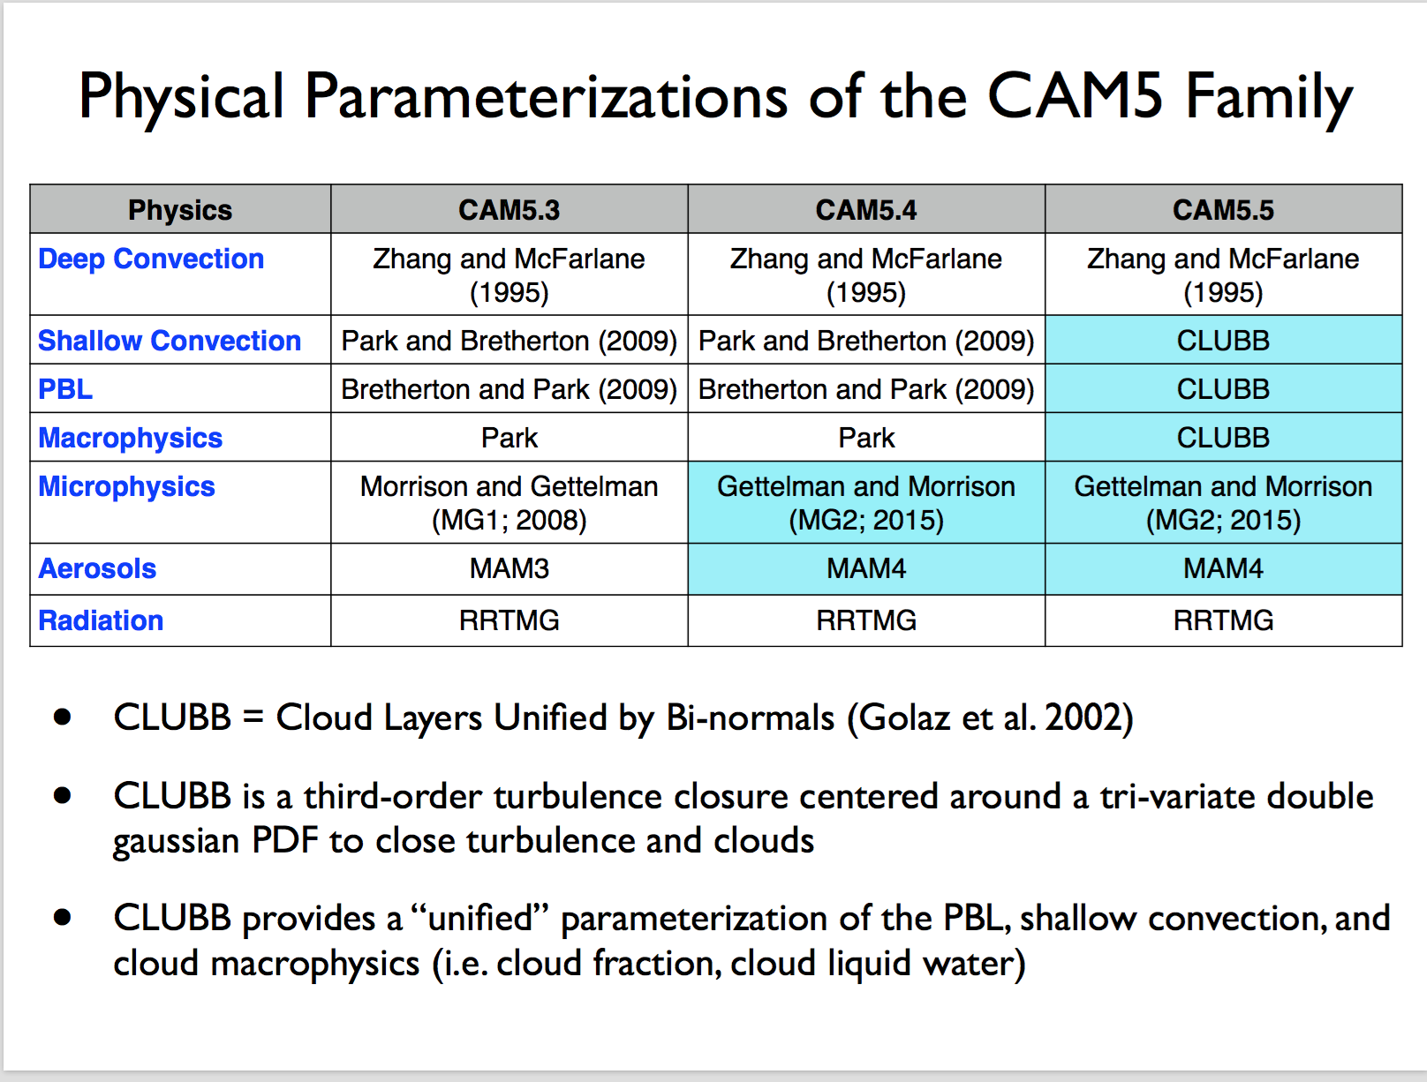

Slide 32
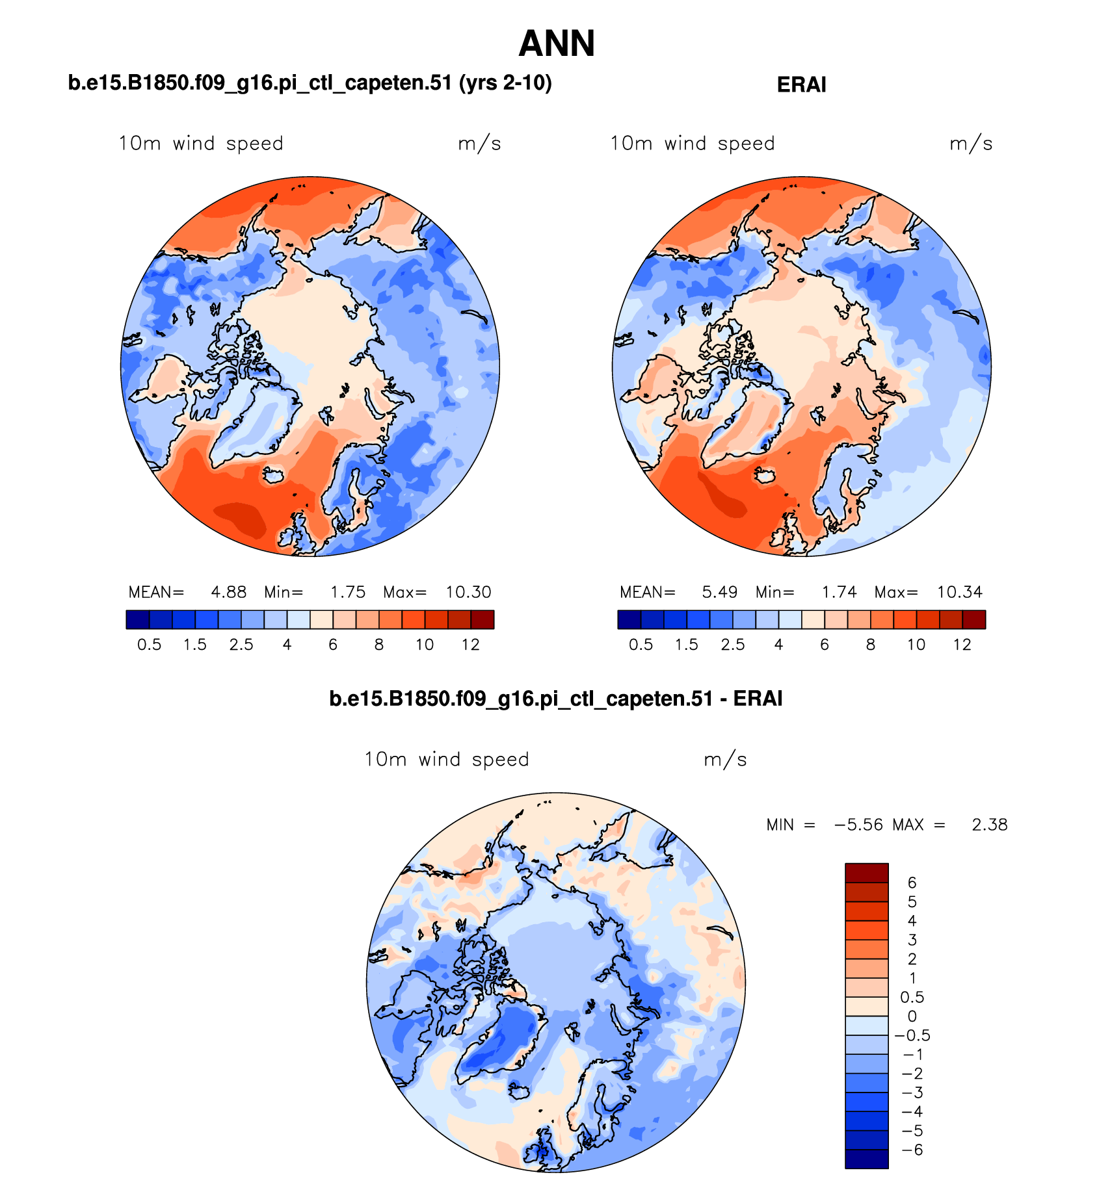
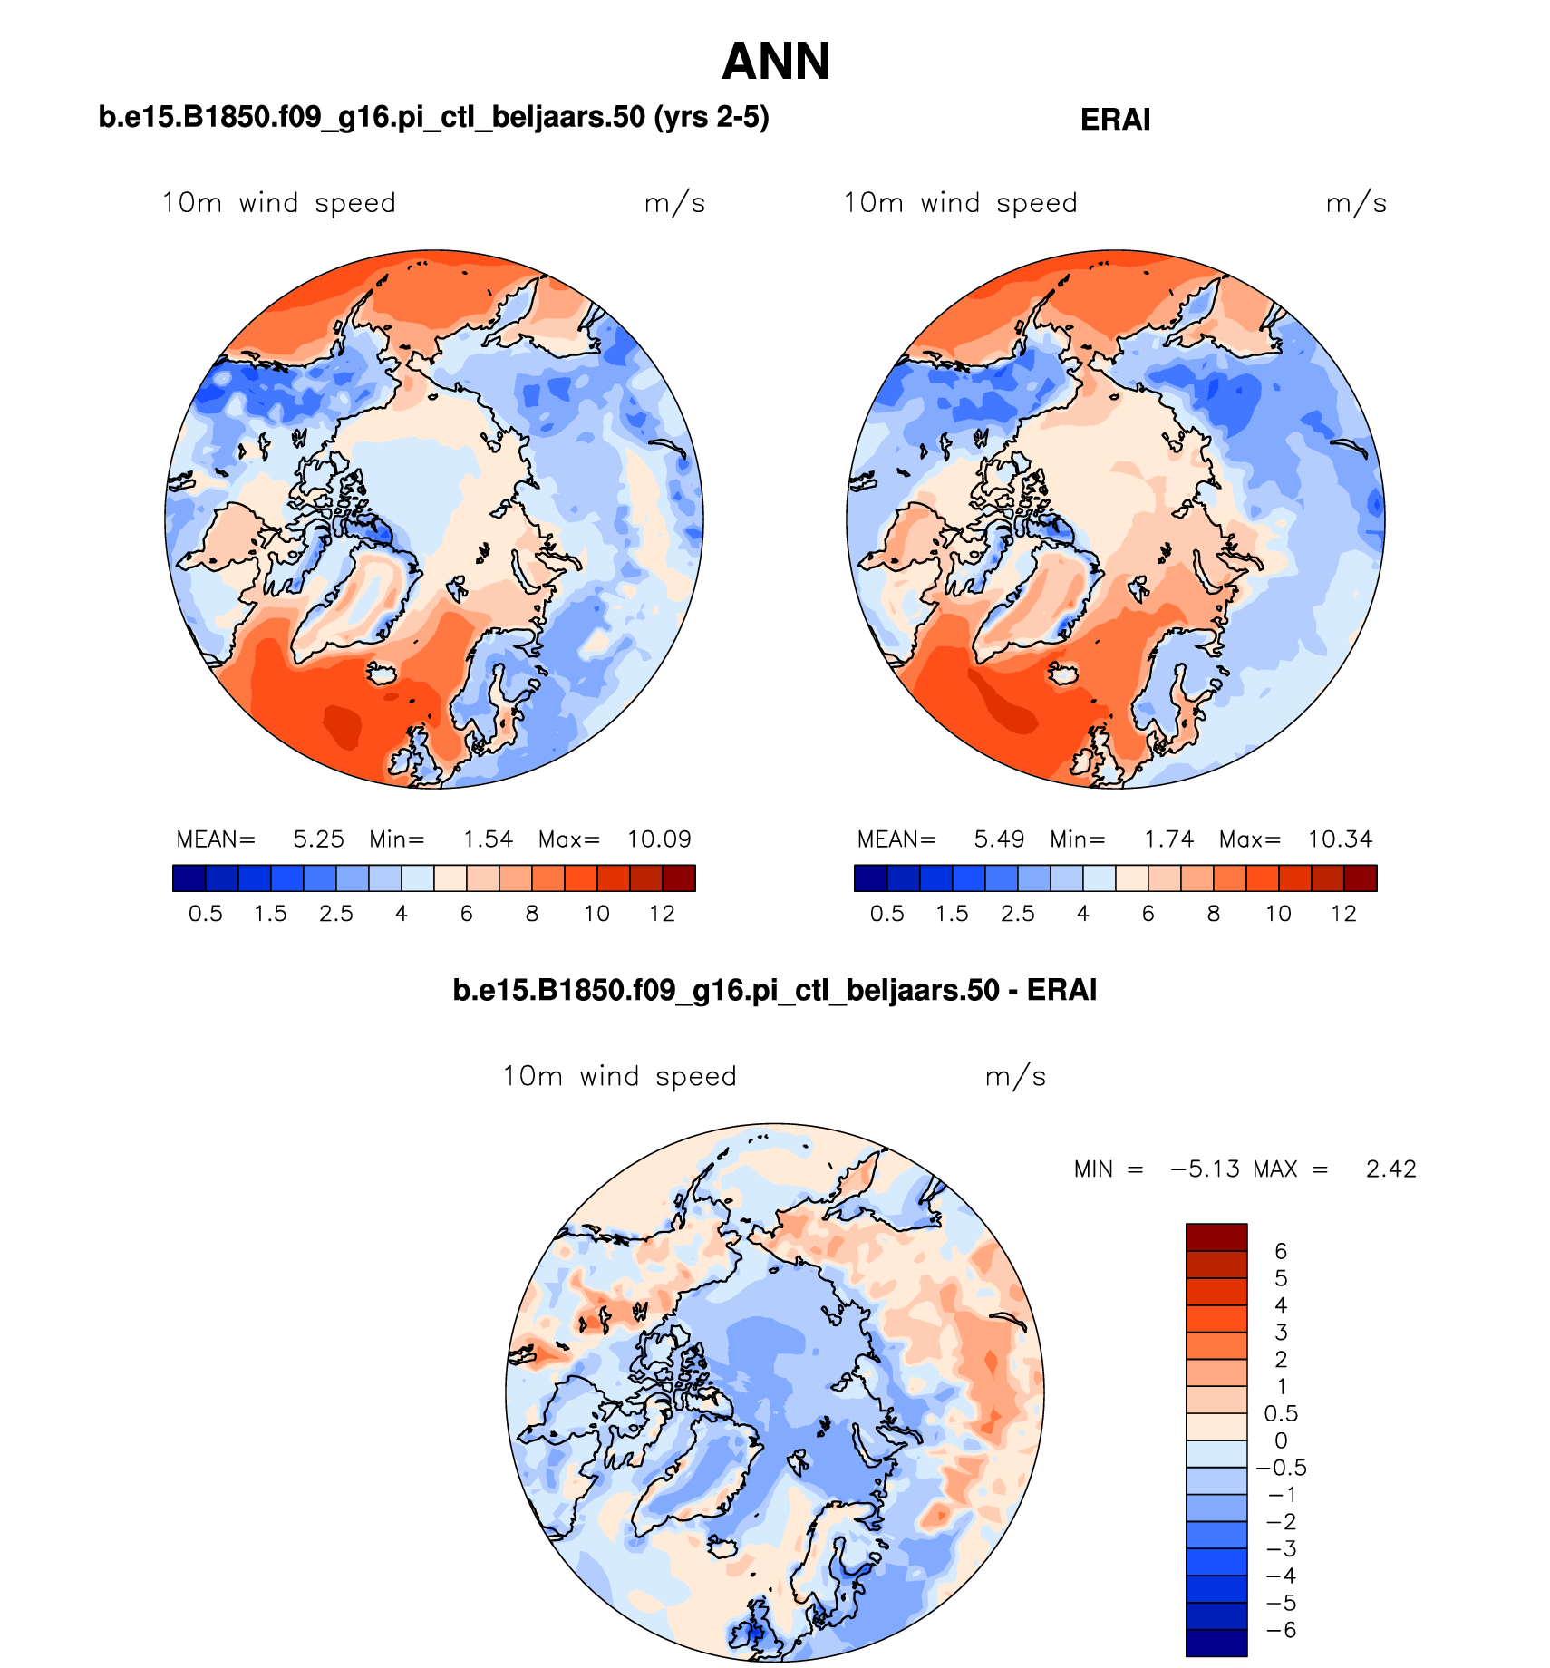
CTL
Beljaars + ridges

Slide 33
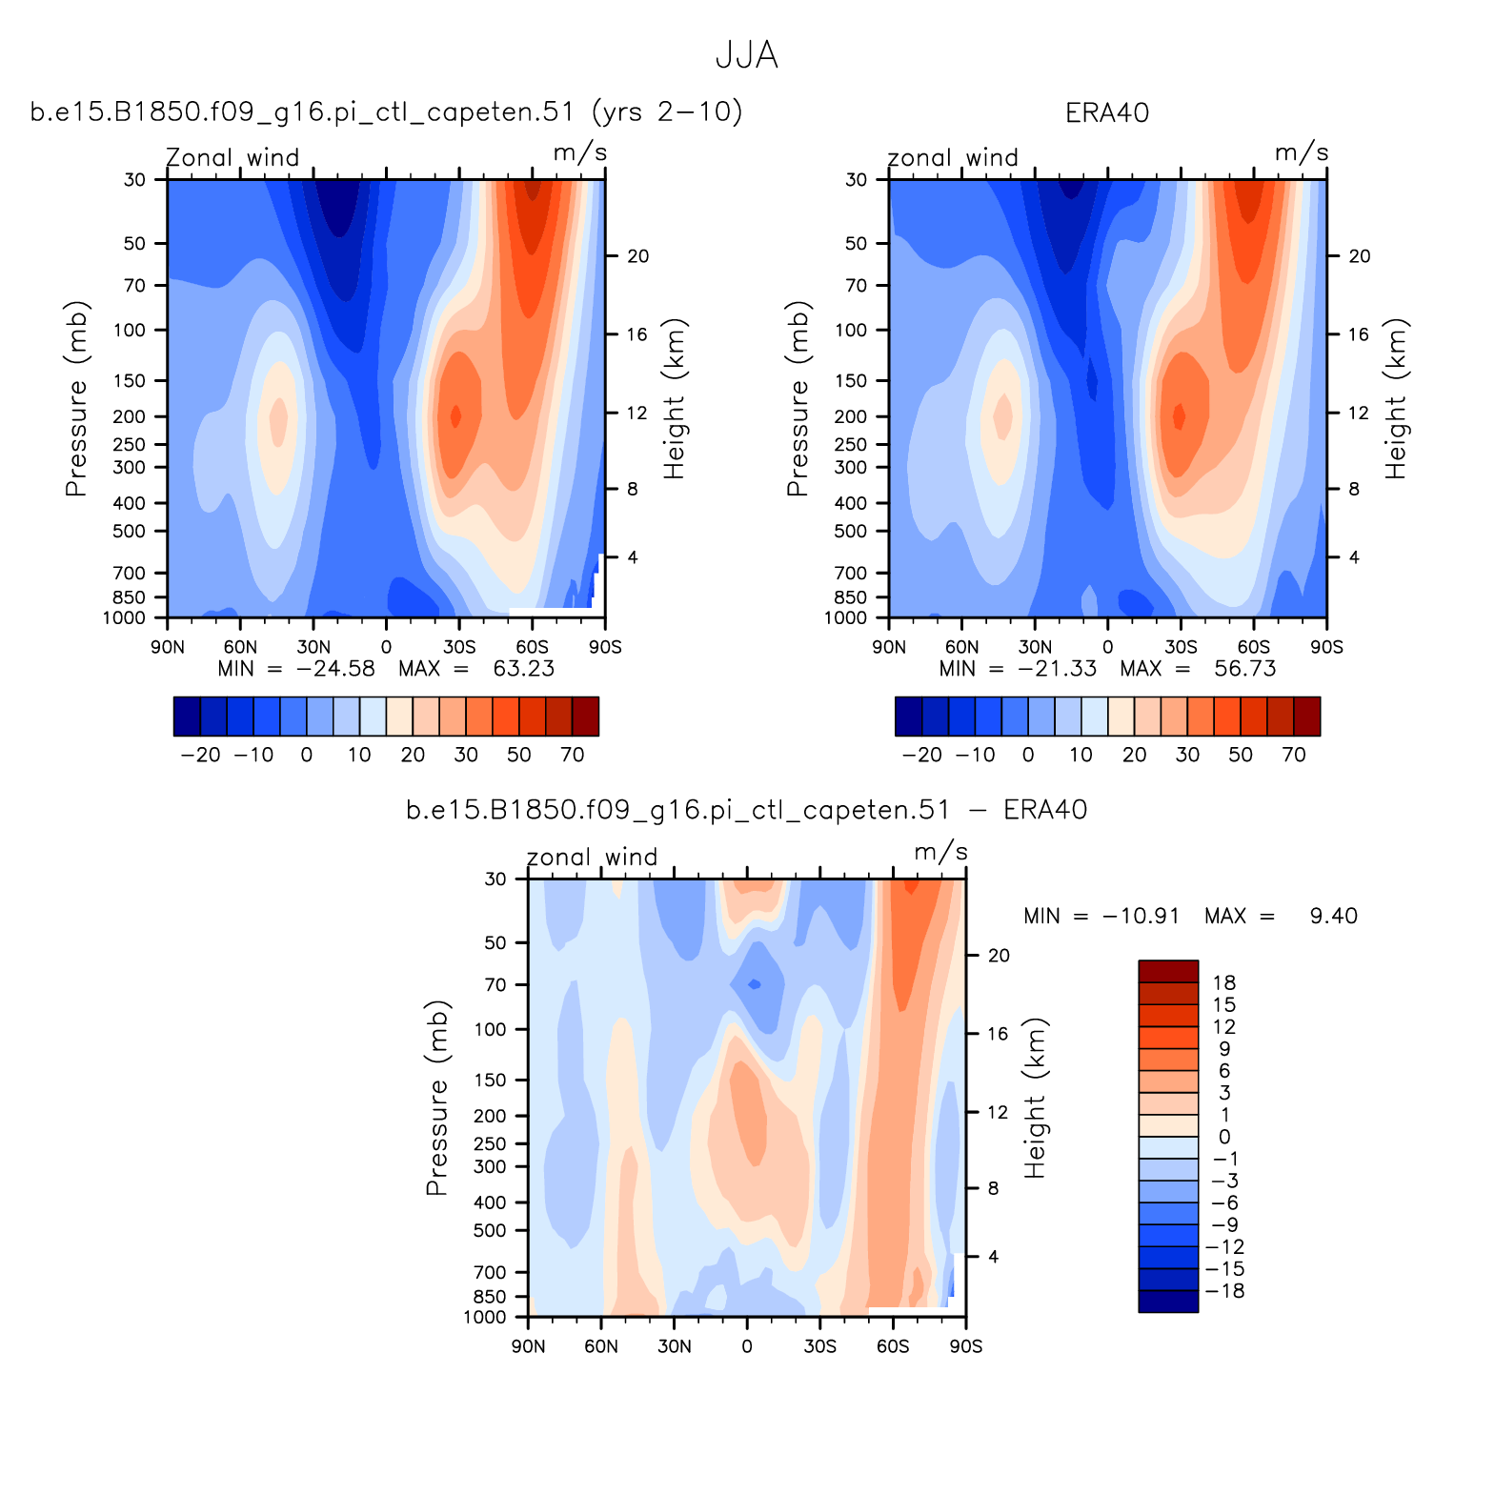
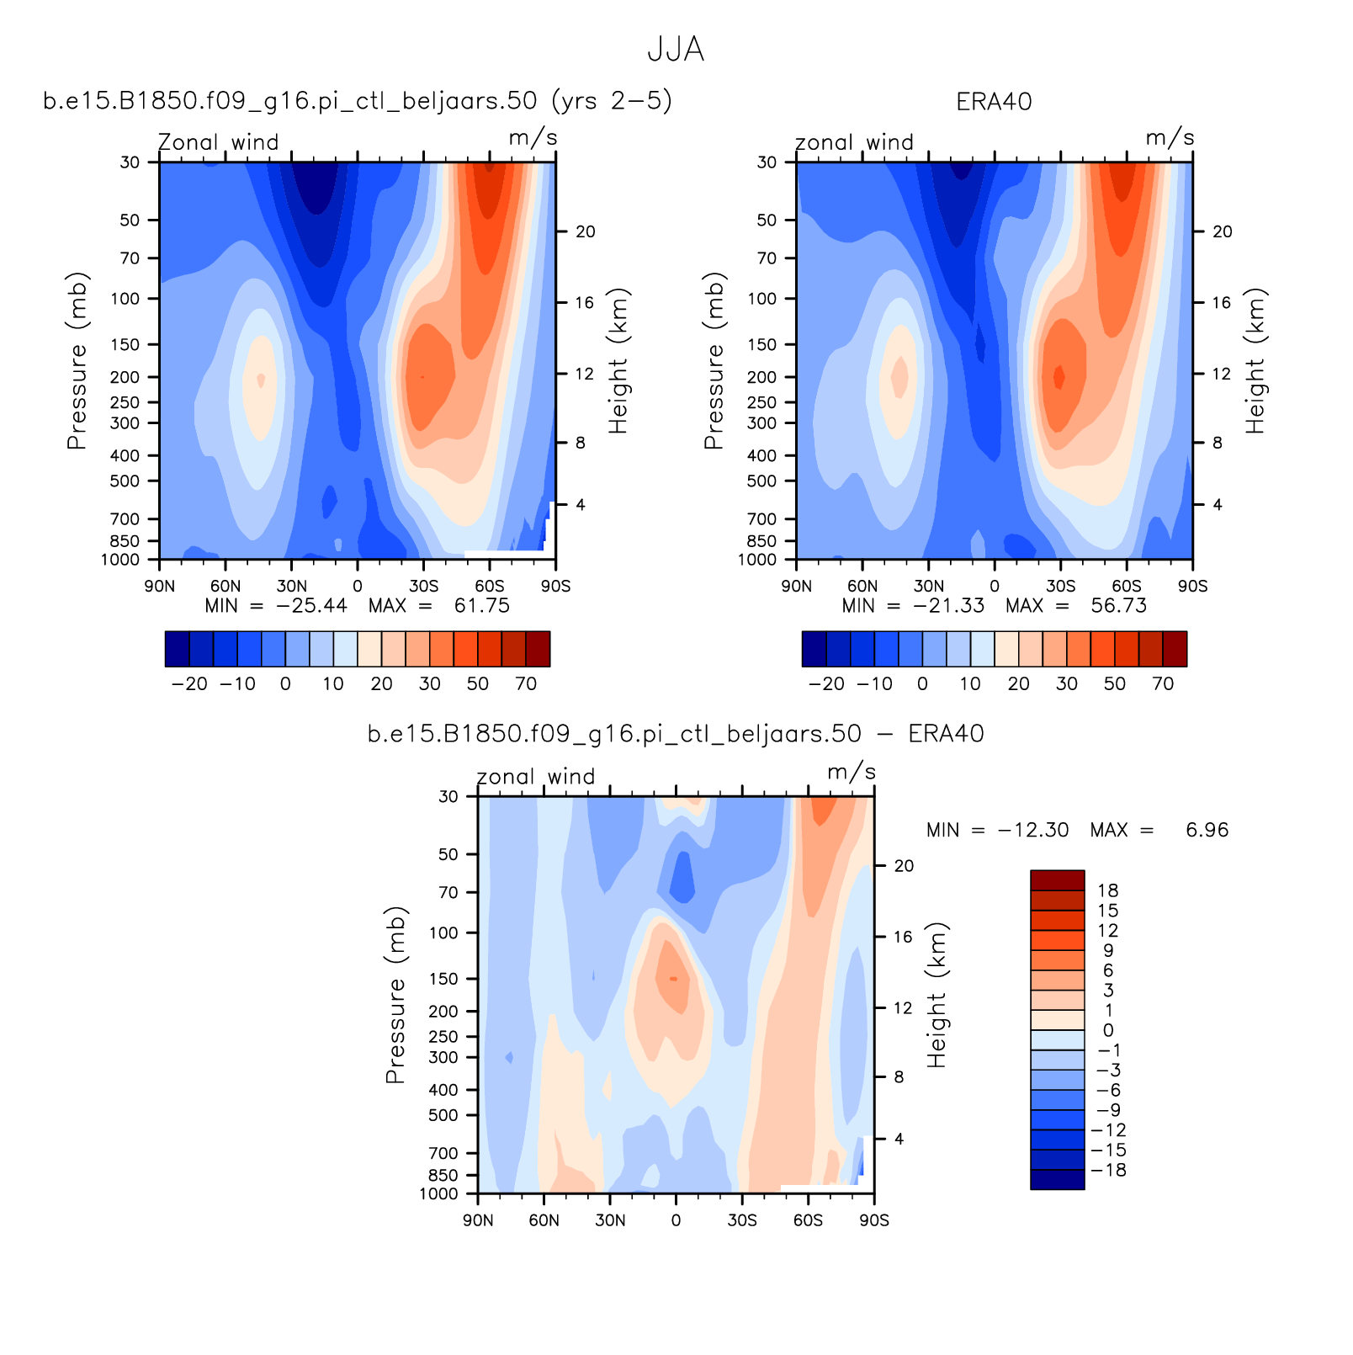
Zonal Mean winds in JJA
(note AMWG plots reversed latitudes N➔S)
CTL
Beljaars + ridges

Slide 34
Subgrid orographic drag: Beljaars vs TMS
τ_{TMS}~SGH30 ➔ τ_{Blj}~SGH30²
D_{TMS}(LM)~C|U|U(LM); D_{TMS}=0 for k<LM
D_{Blj}~F(z)|U|U; F is shallow but grid-independent
Ridge-based (anisotropic) orographic GW scheme:
wave model follow Scinocca and McFarlane
Own “ridge” feature identification

Slide 35
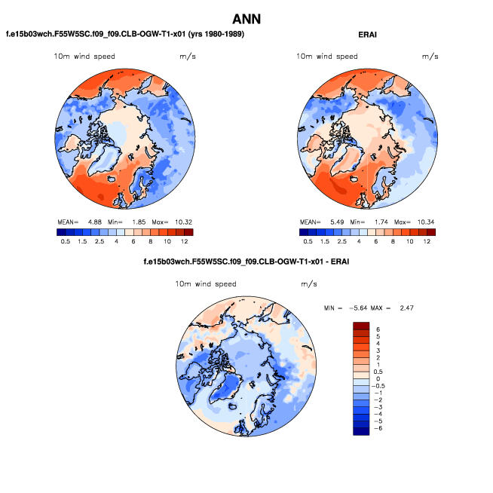
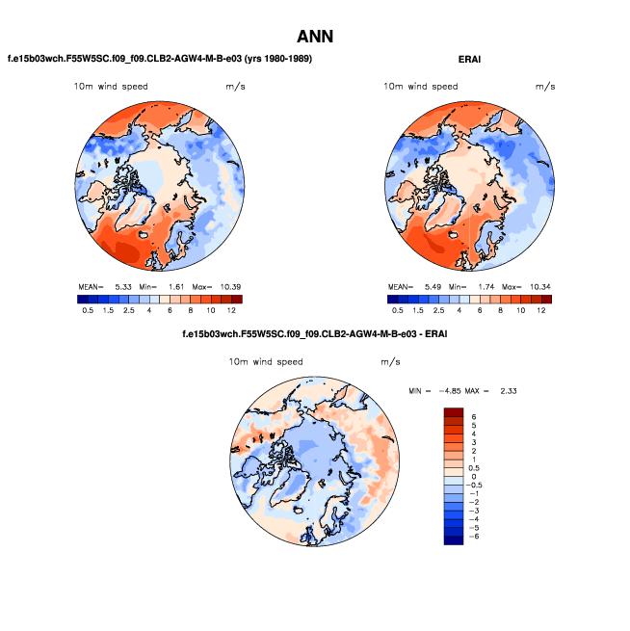

Slide 36
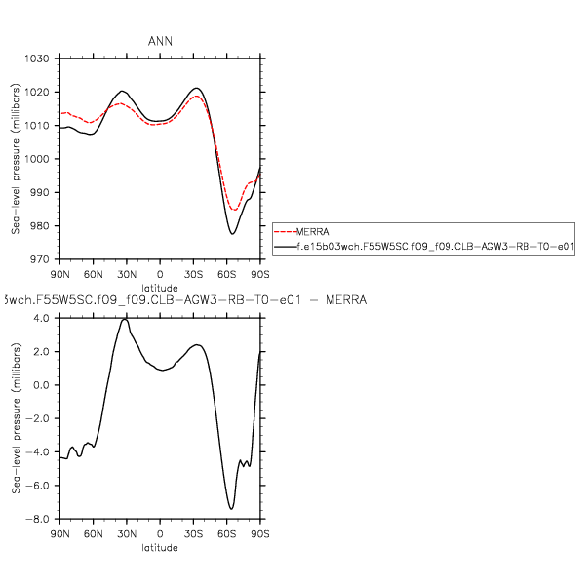
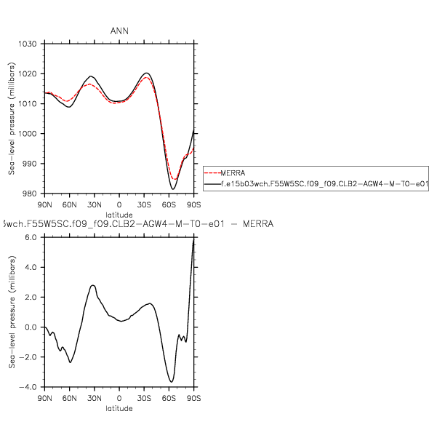
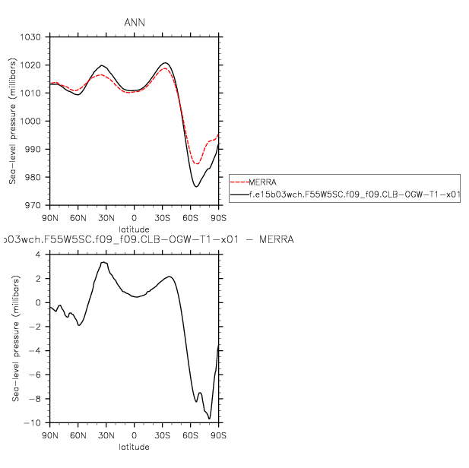
WACCM-CLUBB noTMS+Ani
WACCM-CLUBB OGW
WACCM-CLUBB noTMS+Ani
cK10=0.6

Slide 37
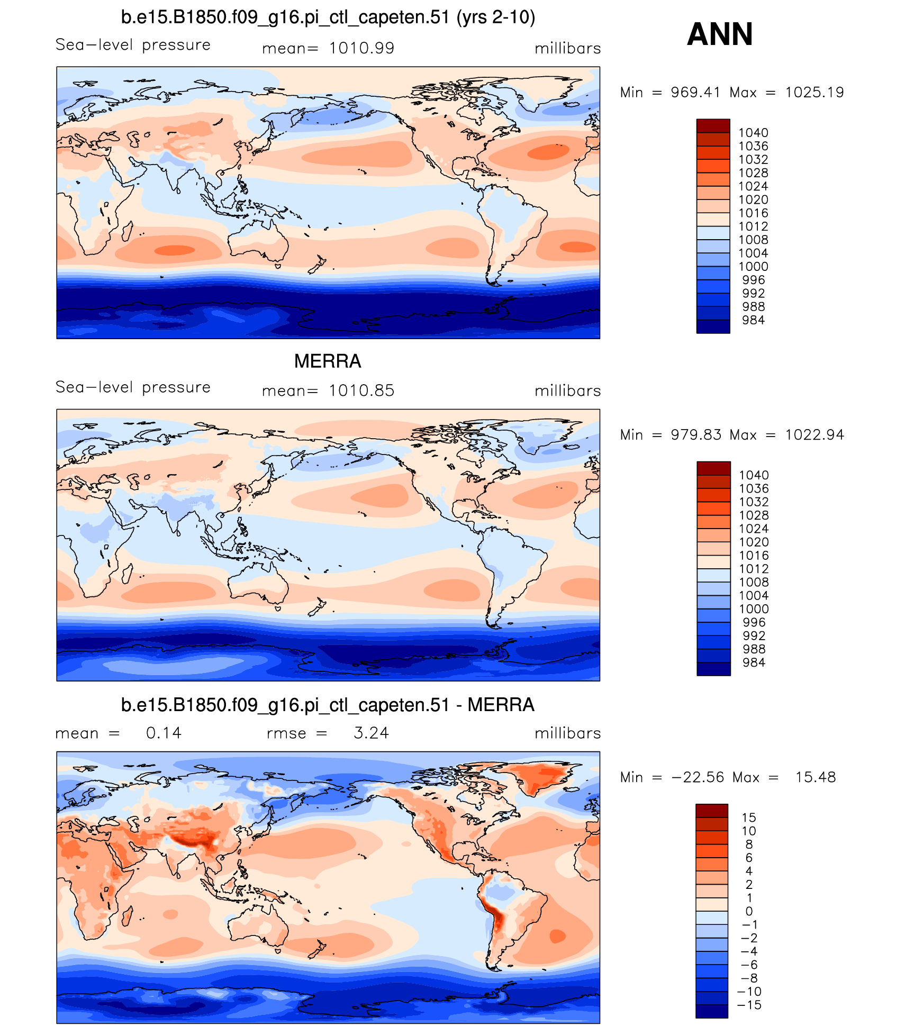
CTL
Beljaars + ridges

Slide 38
CESM tutorial

Slide 39
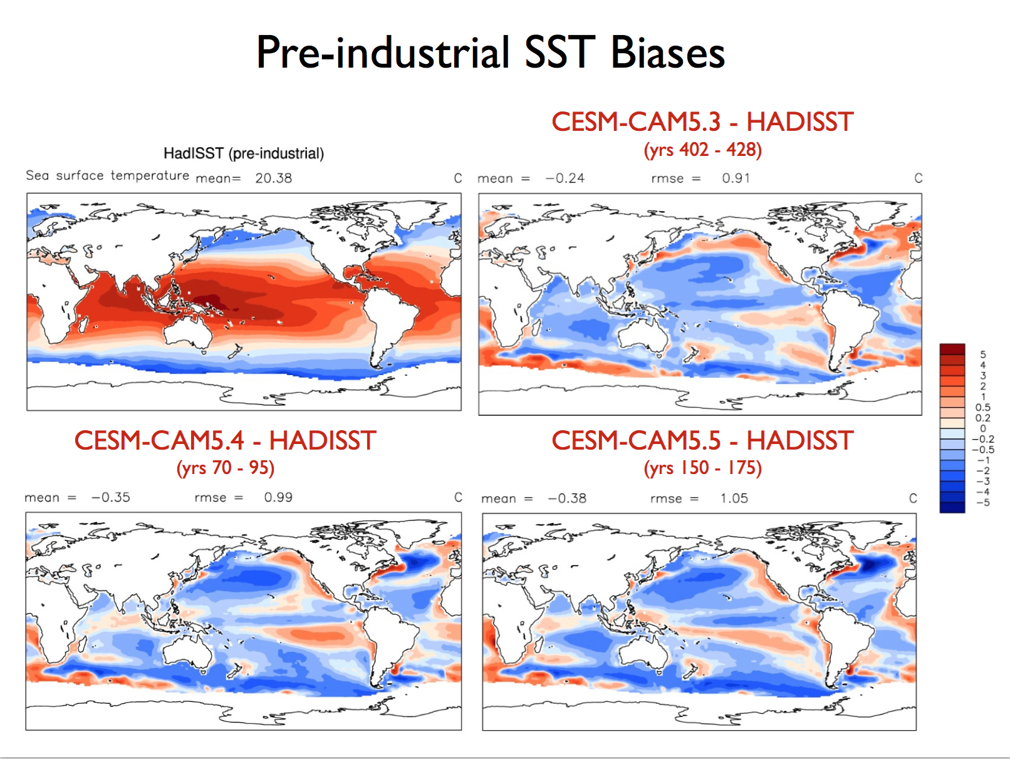

Slide 40
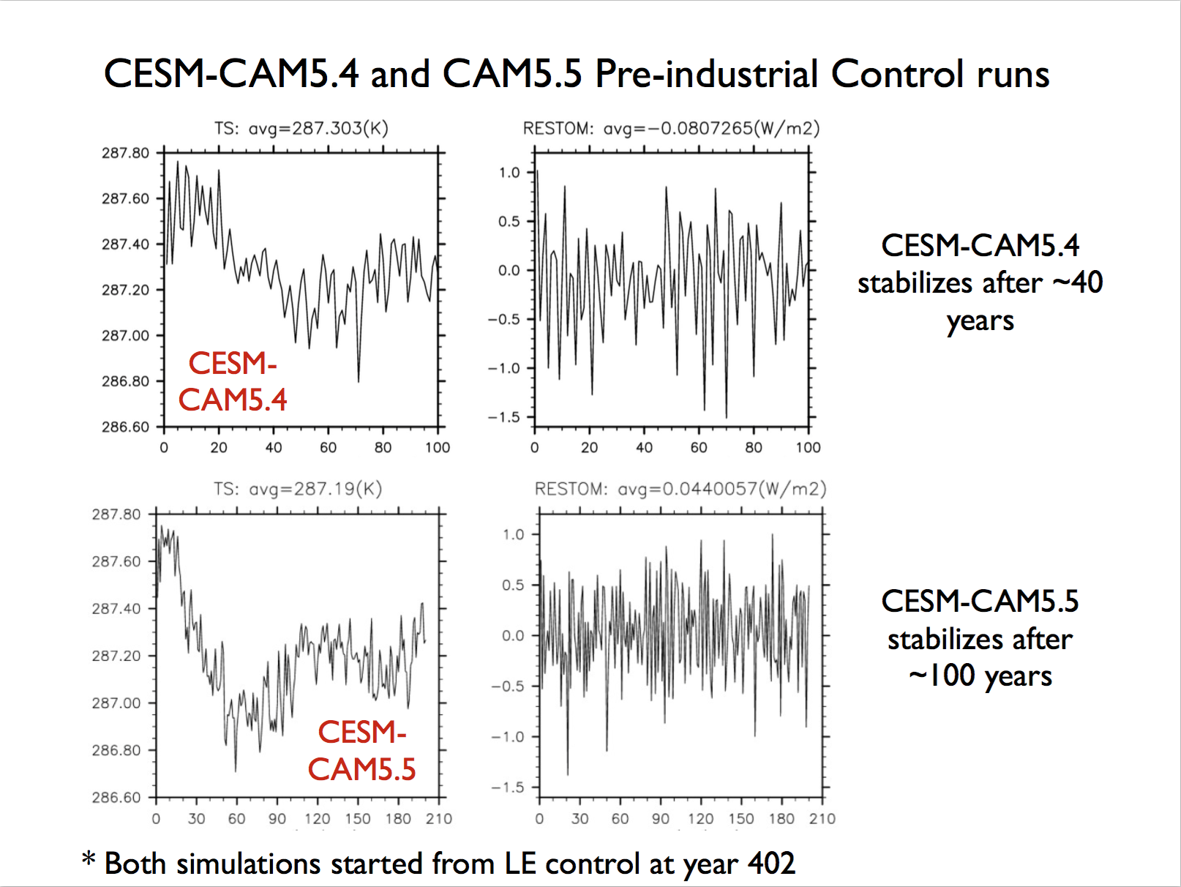

Slide 41
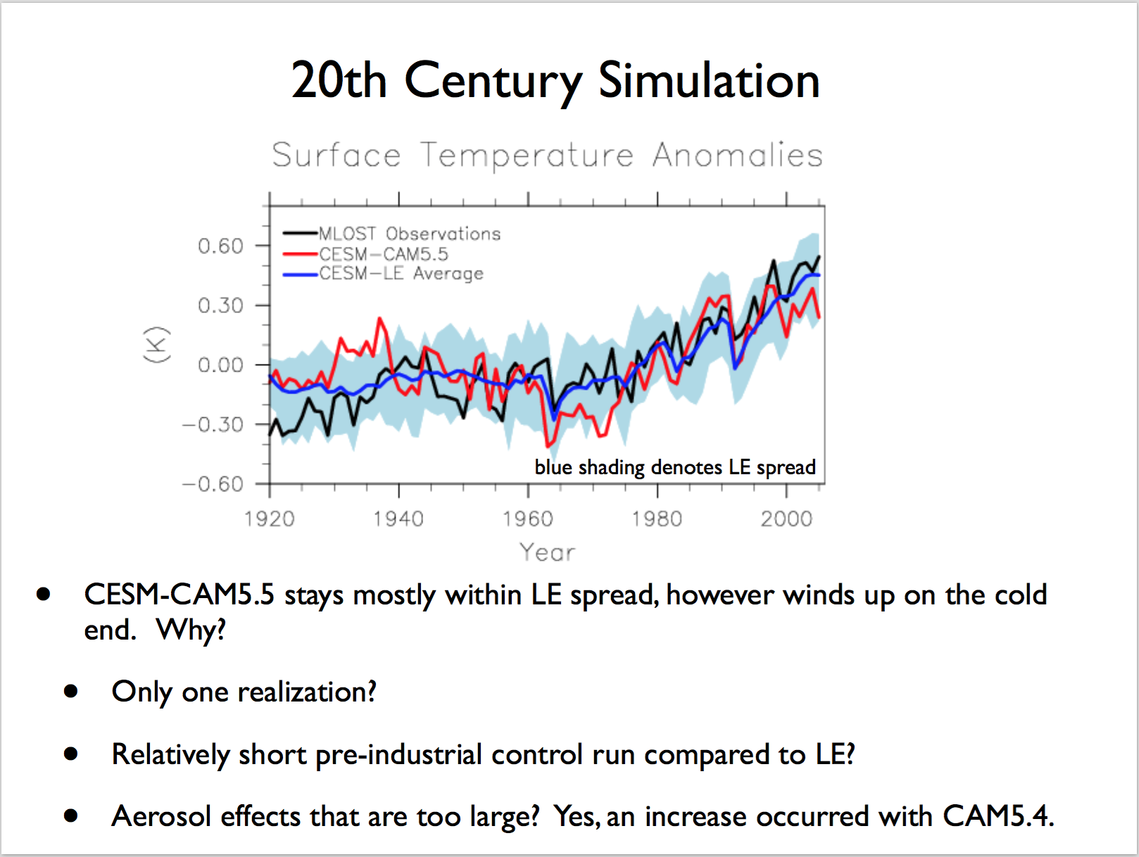

Slide 42
